Slide 2
Taming Unbounded Resources with Node Feature Discovery
Mark Abrams
Notes:
First of all, I just want to take a minute to say that the edge means different things to different stakeholders.
For some, the edge is the edge of the cloud - call it a silver lining if you like
In this presentation, I am talking about the edge beyond the silver lining. I’m looking at the vast blue skies beyond the clouds
For example
Factories
Retail
Energy
Automotive and Aerospace
Smart cities
Devices here are at the edge of the network. The leaf nodes
With that, lets take a look at Node Feature Discovery

Slide 3
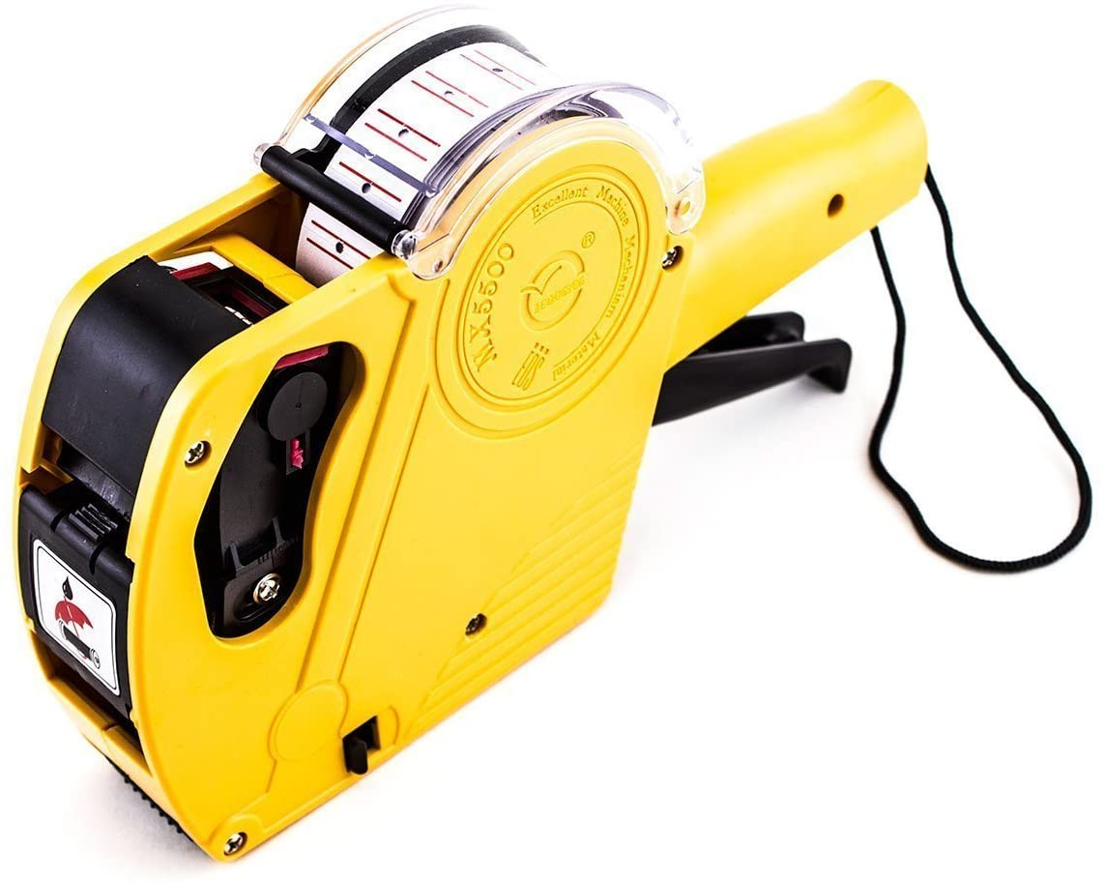
What is Node Feature Discovery (NFD)
NFD is simply a fancy labeler
K8s node labels

Slide 4
Why do I need a labeler
Because we are delivering cattle not pets
Volume - a large number of devices
Efficiency
Accuracy
Resources at the Edge
Are not just CPU and RAM
Are Unbounded
Notes:
Automating work is what we do
With massive numbers of devices, we need to get it right.
Automated labeling can be a great time saver for large numbers of devices
The resource types we are targeting don’t fall neatly into the CPU and RAM category

Slide 5

Why do I need a labeler
Mapping workloads to appropriate resources
Resources
Workloads
Notes:
I think the number one value is for the ease of mapping workloads to resources

Slide 6
Unbounded Resources?
K8s is designed to schedule workloads against resources
In the data center (first class features of k8s)
CPU
RAM
GPU
At the edge (not schedulable by default)
Unlimited number of I/O devices are possible
Sensors
Actuators
Notes:
What id meant by unbounded resources?
I say unbounded because they are not infinite, but there is really no limit to what device might be attached to your node.
Within your individual use case, there is a finite set of target resources. That’s good
At the edge, these could be
USB
GPU
NIC
FPGA
Video IN/OUT
Radios (LoRA/BLE/WiFi)
I2C or other Serial interfaces
ETC.

Slide 7


w/o NFD - Childs Play
Do you have any 3’s
Go fish
Notes:
Without NFD and large numbers of clusters it is like playing a game of go fish.
I don’t know if you are familiar with this game
basically you take turns with your opponents asking if they have the resource you need
it’s a guessing
In the real world, you shouldn’t just guess which devices have the right resources
NFD takes the guesswork out of it

Slide 8
Consistency of Device Types
Fortunately edge deployments are done as batches
Enterprises purchase a large quantities of the same thing
We can reduce the number of device configurations needed
In any given vertical
100s or thousands of the same device
Devices can be single or multi- node clusters
NFD operates per node
Notes:
Typically within an enterprise, there are constraints.
If we buy 1k or 100k computers, we try and buy similar systems.
There is an efficiency in both cost and management when doing this.
Also, typically we are using devices to address a specific problem.
For some a camera is an AI input device
For others a camera is a security input device
Even if we have 10 different cameras, that is a constraint and we can use it to our advantage when working with large numbers of devices.
Fortunately, NFD is flexible so you can target Any camera or a specific model of camera.
These are just examples. Not everything is a camera of course.

Slide 9
How does it work
Two DaemonSets
NFD Master
NFD Worker
Notes:
Very simply
NFD-Master is a Deployment and it is responsible for communication towards the Kubernetes API. That is, it receives labeling requests from the worker and modifies node objects accordingly.
NFD-Worker is a DaemonSet and it is responsible for feature detection. It then communicates the information to nfd-master which does the actual node labeling.

Slide 10
How does it work
Operations team responsibilities
Know your devices
Create configuration defining known resources
NFD does the rest

Slide 11
Let’s Deploy NFD
CRDs
K8s templates (yaml config)
Helm Chart
Operator
NFD does what it does based on a configmap
Configmap is the key to the labeling

Slide 12
Example ConfigMap
Notes:
This is pretty simple, I run NFD with my unique configmap and labeling happens.
There is one small issue.
Operations that are managing 100s or thousands of devices, also periodically add, remove or update their systems.
Now my configmap has to change accordingly or else I need to start managing multiple versions of it.
Which would you rather do:
Manage one config map or
Manage the management of multiple configmaps.
To illustrate why I’m asking this question, let’s do a quick review of edge architectures.

Slide 13

Quick Architecture Review
Data Center / Cloud
dev
test
staging
prod
Notes:
Red lines represent the cluster boundaries.
This is a typical scenario in cloud and data centers

Slide 14
Quick Architecture Review
Data Center / Cloud
dev
test
staging
prod
Edge
Notes:
Compare that with a tiny edge scenario
There are only 32 clusters in the edge image so we’re talking easily 10 or 100x this visual representation for some deployments
Now, in your mind, add and remove a few clusters at the edge - let the clusters be ephemeral
What changed on the new devices you added,
Go Fish?
I don’t think so
So, I ask again, At the Edge
Which would you rather do:
Manage one config map or
Manage the management of multiple configmaps.

Slide 15
GitOps for Apps and NFD at the Edge
Rancher Fleet
Argo CD
Flux
Notes:
Hopefully you chose to manage one single configmap.
Of these 3 tools, I am only familiar with Fleet so I cannot really talk about the other 2.
In Fleet, it is possible to manage large numbers of clusters and target workloads and custom configs to the clusters based on matching.
One gap here is that we do not have an auto cluster labeler, we have an
Cluster is a CRD in fleet, not in Kubernetes. That means each gitops tool may be offering a different solution
Cluster API may hold the answer.

Slide 16
Example gitops workflow
Install NFD via the gitops pipeline into every cluster
Setup NFD configmap and commit to pipeline
Notify developers
of the labels available
and what resource it maps to
Repeat steps 2 and 3 on changes

Slide 17
Links
https://kubernetes-sigs.github.io/node-feature-discovery/v0.8/get-started/
https://kubernetes-sigs.github.io/node-feature-discovery/v0.8/get-started/features.html
https://www.usb.org/defined-class-codes

Slide 18
Setting up USB detection
Configmap now has
feature.node.kubernetes.io/usb-ff_0424_ec00.present:true
Notes:
Notice, on the first output line, that’s the Ethernet adapter.
This is a turingpi with 7 RasberryPi CM3+ modules attached.
Let’s see if we can detect something plugged into one of the hubs on device 002 or 001

Slide 19
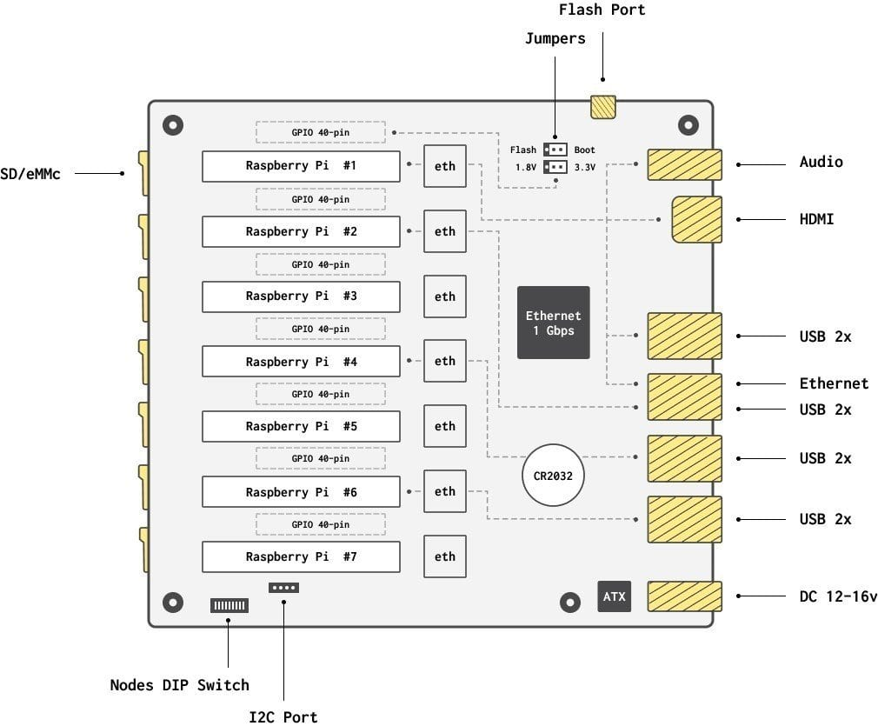
Setting up USB detection
Turingpi v1
Notes:
Here’s a diagram of the device.
My master node is on the last one labeled #7 in this diagram
I plugged a device into the usb port that’s connected to #4 (which is named turingpi03 in my cluster)

Slide 20
Setting up USB detection
Turingpi v1

Slide 21
Setting up USB detection
cluster node 3
markabrams@mak3r:~/dev/nfd-demo$ ssh tp3 lsusb
Warning: Permanently added the ECDSA host key for IP address 'fe80::d6d1:e799:44cf:e359%en13' to the list of known hosts.
Bus 001 Device 004: ID 0c45:7603 Microdia
Bus 001 Device 003: ID 0424:ec00 Standard Microsystems Corp. SMSC9512/9514 Fast Ethernet Adapter
Bus 001 Device 002: ID 0424:9514 Standard Microsystems Corp. SMC9514 Hub
Bus 001 Device 001: ID 1d6b:0002 Linux Foundation 2.0 root hub
markabrams@mak3r:~/dev/nfd-demo$ ssh tp6 lsusb
Bus 001 Device 003: ID 0424:ec00 Standard Microsystems Corp. SMSC9512/9514 Fast Ethernet Adapter
Bus 001 Device 002: ID 0424:9514 Standard Microsystems Corp. SMC9514 Hub
Bus 001 Device 001: ID 1d6b:0002 Linux Foundation 2.0 root hub
Notes:
Comparing it to the other node we looked at,
we can see now a microdia device

Slide 22
Setting up USB detection
cluster node 3 - usb labels
feature.node.kubernetes.io/usb-ff_0424_ec00.present:true
Notes:
But it still doesn’t show up as a label on our node
Let’s find out the configuration we need to set up

Slide 23
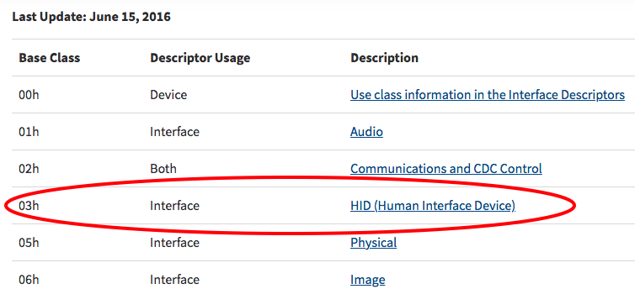
Setting up USB detection
Class=Human Interface Device
https://www.usb.org/defined-class-codes
markabrams@mak3r:~/dev/nfd-demo$ ssh tp3 lsusb -t
/: Bus 01.Port 1: Dev 1, Class=root_hub, Driver=dwc_otg/1p, 480M
|__ Port 1: Dev 2, If 0, Class=Hub, Driver=hub/5p, 480M
|__ Port 1: Dev 3, If 0, Class=Vendor Specific Class, Driver=smsc95xx, 480M
|__ Port 3: Dev 4, If 0, Class=Human Interface Device, Driver=usbhid, 1.5M
|__ Port 3: Dev 4, If 1, Class=Human Interface Device, Driver=usbhid, 1.5M
Notes:
We need more info and we’ll cross reference the device specs at usb.org
hex 03 is what we’re looking for.

Slide 24
Setting up USB detection
Default for usb configuration in NFD
# usb:
# deviceClassWhitelist:
# - "0e"
# - "ef"
# - "fe"
# - "ff"
# deviceLabelFields:
# - "class"
# - "vendor"
# - "device"

Slide 25
Setting up USB detection
Modified usb configuration in NFD
usb:
deviceClassWhitelist:
- "03”
# - ”0e"
# - "ef"
# - "fe"
# - "ff"
deviceLabelFields:
- "class"
- "vendor"
- "device"
Notes:
I do not know how it found the USB ethernet device

